Slide 1
ENGLISH LANGUAGE CAI
SCHOOL: St. John’s S.S Wakitaka
SENIOR: THREE
TERM TWO
Theme: Personal/Public
Topic: Relationships and Emotions
Learning outcomes:
- Identify different types of relationships within the family.
- Express emotions.
- Recognize and appreciate the different types of relationships and emotions.
- Realize the consequences of some relationships, such as with members of the opposite gender.

Slide 2
Subject competency: The learner speaks about relationships and emotions.
Generic skills: Learner exhibits communication skills
Learning Domain: Psychomotor

Slide 3
ABILITY LEVEL | IMITATION | MANIPULATION | PRECISION | ARTICULATION | NATURALISATION
SITUATION / CONTEXT | During the term, the Writers Club had a poetry (poem writing) competitions on the theme “Love”. Among the competitors was the s.3 student whose poem was exceptional. His/her poem is as extracted below. | The Music, Dance and Drama (M.D.D) club in your school has organized the inter-class competitions on the theme “Love is a beautiful feeling”. | You read the poem below, entitled “The woman with whom I share my husband” and now it is time to speak about the feelings of any character. | The patron Debate club of your school has organized an inter-school Debate tournament with your neighboring school on the resolution(motion) “Fathers should take custody of the children in the case of divorce”. | In your class the learners have mixed reactions about abstaining from sex until marriage. You realize that a bigger percentage of the class, especially boys is against virginity. As a concerned classmate, you decide to intervene to bring order to the class.

Slide 4
TASK
 | Pass on the message to the classmates just as the poet has done. | Follow these instructions and recite a poem about the person you love most to the audience. 1. In your poem, show the relationship you have with the person and why. 2.Provide relevant examples to support your ideas. 3. Clearly express your feelings/opinions/ attitude. 4.Speak audibly. 5. Speak articulately. 6. Use your body language/non-verbal appropriately. 7.Use vocabulary related to relationships and emotions. | Individually, speak about the feelings of your character of your choice. | Organize four of your classmates and hold a debate on the motion for the tournament You can either propose /oppose the motion. | Speak to the class as you share your opinion.

Slide 5
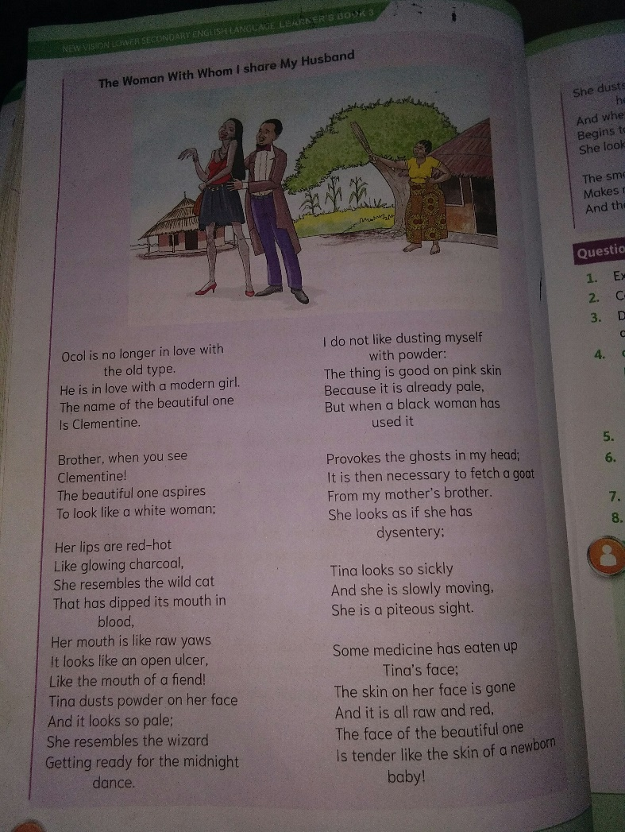

Slide 6
